Slide 1
Robot Sprint
Presented by: McKayla Miksza, Julia Buck
Presented by McKayla Miksza and Julia Buck

Slide 2
Challenges
Aligning the robot with the tape
Matching speed and time variables with the actual lengths of the tape
Matching the angles with the tape
Team members did not have flexible schedules

Slide 3
Participation
McKayla Miksza
Julia Buck
Develop a Plan (Gantt Chart)
Build a Requirements Table
Requirements Sign-off Table.
Build a Flowchart
Create a Test Table
Create the Algorithm
Testing Process
System Design Document
Upload documents to Repository
Develop a Plan (Gantt Chart)
Requirements Sing-off Table.
Create the Block Code
Create the Staffing Plan
Testing Process
Take Robot Course Completion Video
Take Screenshot of Sensor Data
System Design Document
Upload Documents/Video to Repository

Slide 4
Software Engineering
Learned to apply the engineering process to the program to apply it to the robot for the intended course
Design
Develop
Maintain
Test
Evaluate

Slide 5
Second Chances
Sprint 2 - Accuracy looping eight times on the line

Slide 6
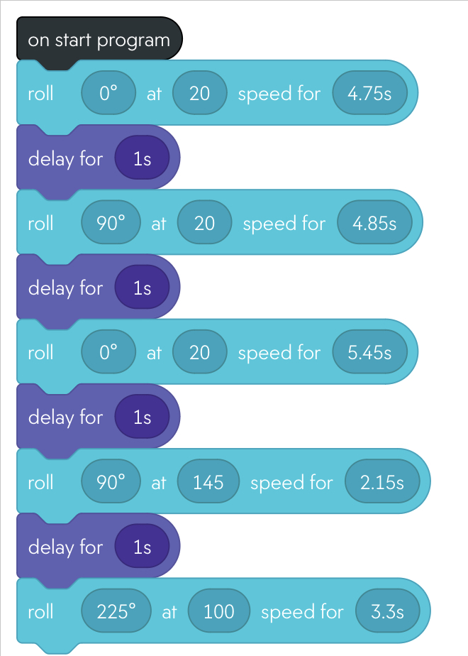

Sprint 3
Block Code
Video

